Slide 1
15-780 – Graduate Artificial Intelligence:
Optimization
Aditi Raghunathan

Slide 2
Outline
Introduction to optimization
Types of optimization problems, convexity
Solving optimization problems

Slide 3
Outline
Introduction to optimization
Types of optimization problems, convexity
Solving optimization problems

Slide 4
Continuous optimization
The problems we have seen so far (i.e., search) in class involve making decisions over a discrete space of choices
An amazing property:
One of the most significant trends in AI in the past 15 years has been the integration of optimization methods throughout the field
 | Discrete search | (Convex) optimization
Variables | Discrete | Continuous
# Solutions | Finite | Infinite
Solution complexity | Exponential | Polynomial

Slide 5
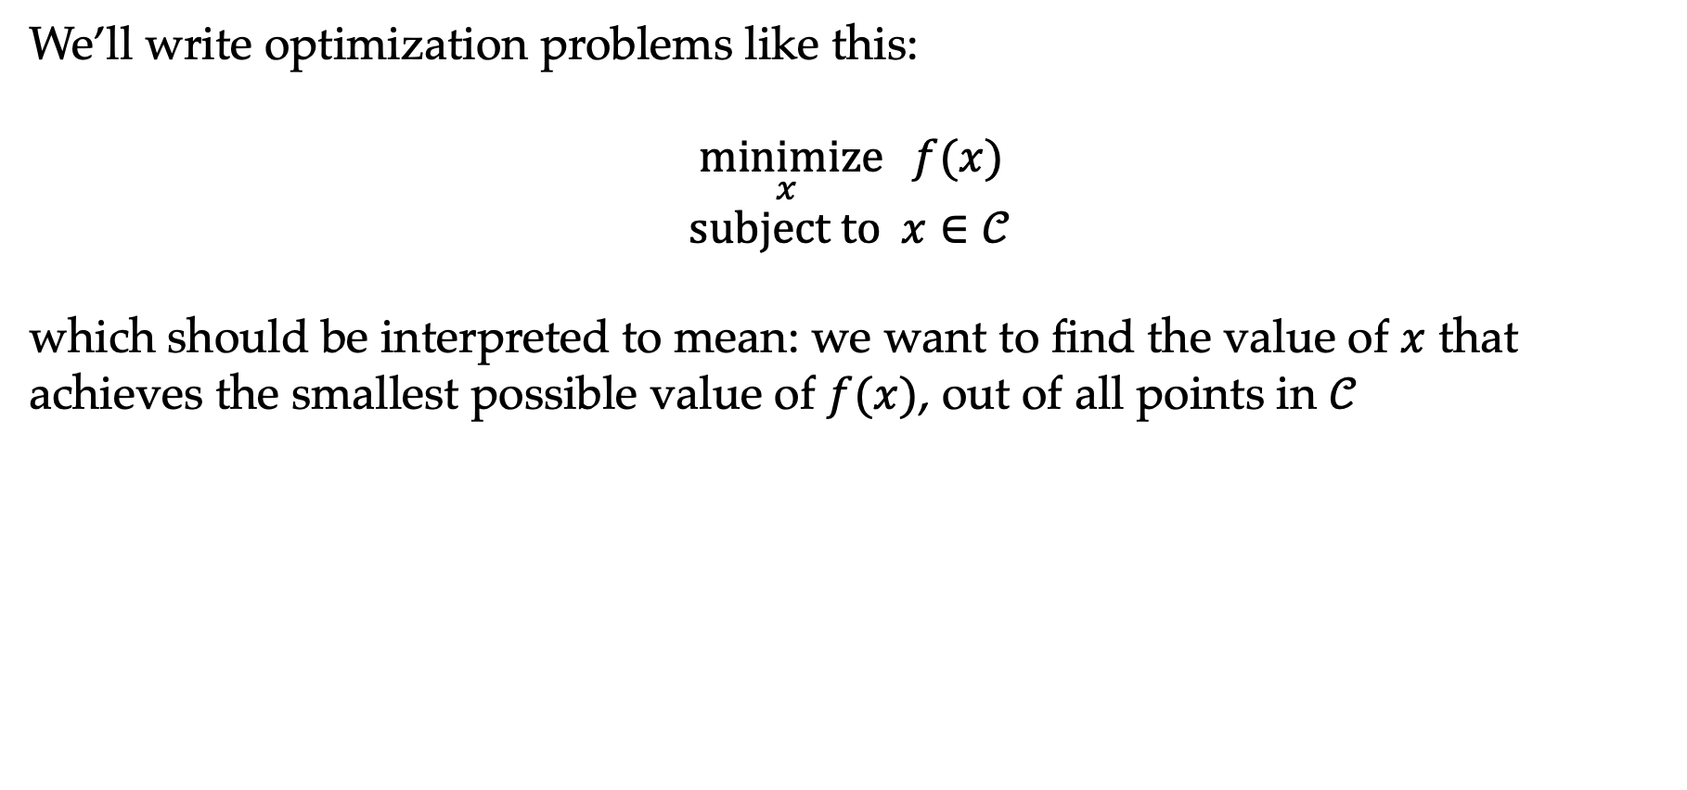
Optimization definitions
We’ll write optimization problems like this:
$$\underset{x}{minimize}{ f(x)} \\ subject to x∈𝒞$$
which should be interpreted to mean: we want to find the value of $x$ that achieves the smallest possible value of $f(x)$, out of all points in $𝒞$

Slide 6
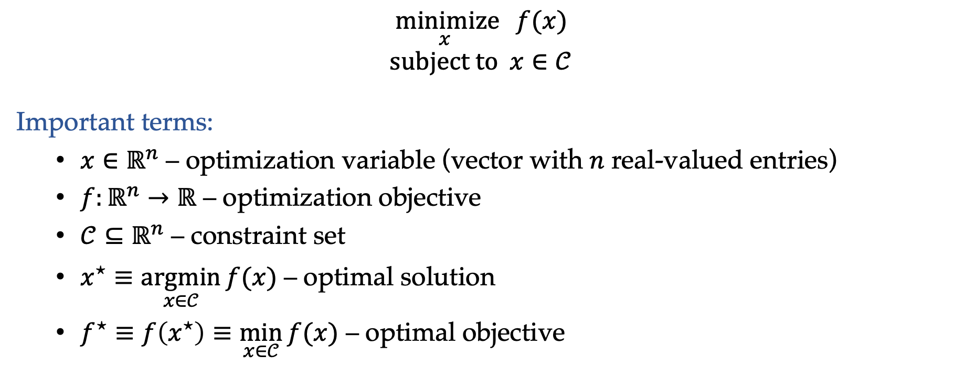
Optimization definitions
$$\underset{x}{minimize}{ f(x)} \\ subject to x∈𝒞$$
Important terms:
  $x∈ℝ^{n}$ – optimization variable (vector with $n$ real-valued entries)
  $f:ℝ^{n}→ℝ$ – optimization objective
  $𝒞⊆ℝ^{n}$ – constraint set
  $x^{⋆}≡\underset{x∈𝒞}{argmin}{f(x)}$ – optimal solution
  $f^{⋆}≡f\left(x^{⋆}\right)≡\min_{x∈𝒞}{f(x)}$ – optimal objective
Notes:
Not all solutions are allowable – we capture that via constraint. For example: you don’t want a robot to move backwards, or move too fast
X* is the assignment of values to the variables
Min vs argmin vs minimize (min is a mathematical operator that returns the minimum value, argmin is the assignment, minimize is the problem). Argmin could be a set, doesn’t have to be a unique element
Objective is always real valued, even if takes in a vector of inputs

Slide 7
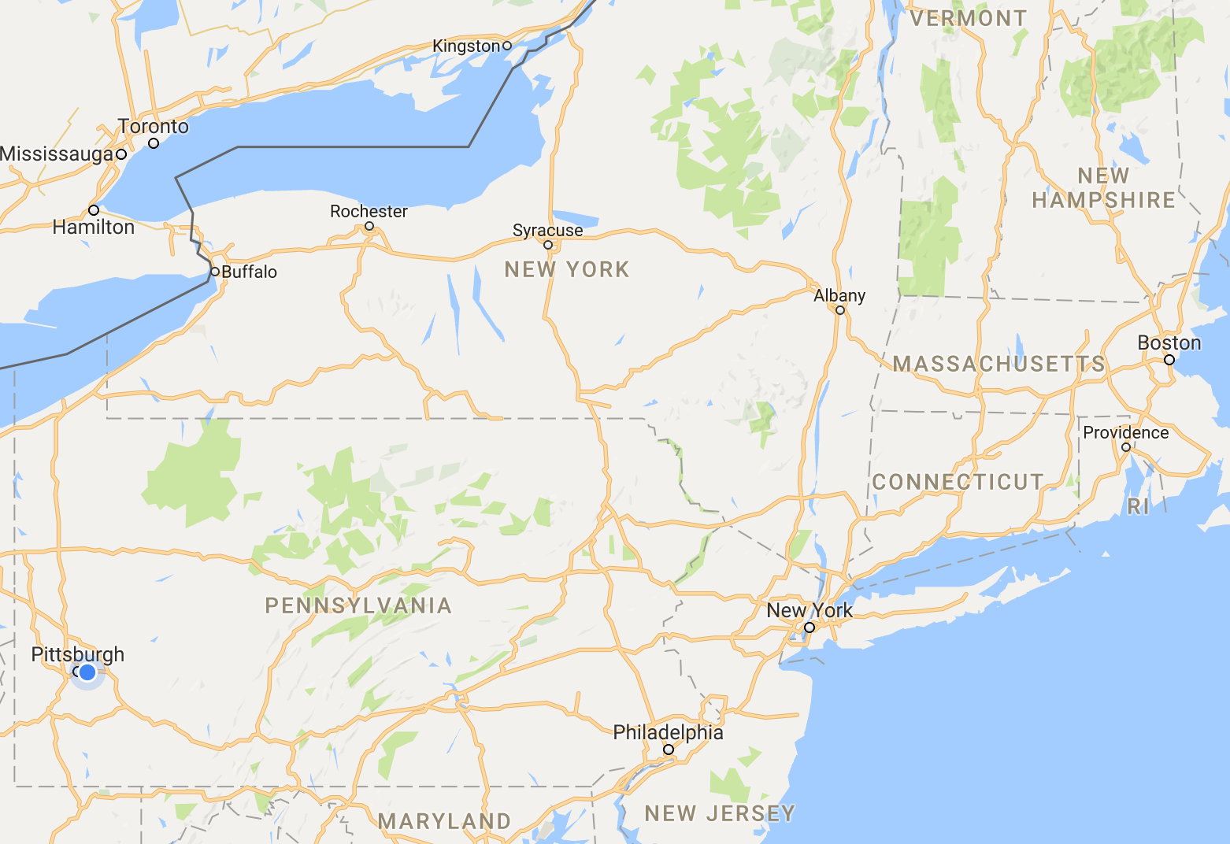
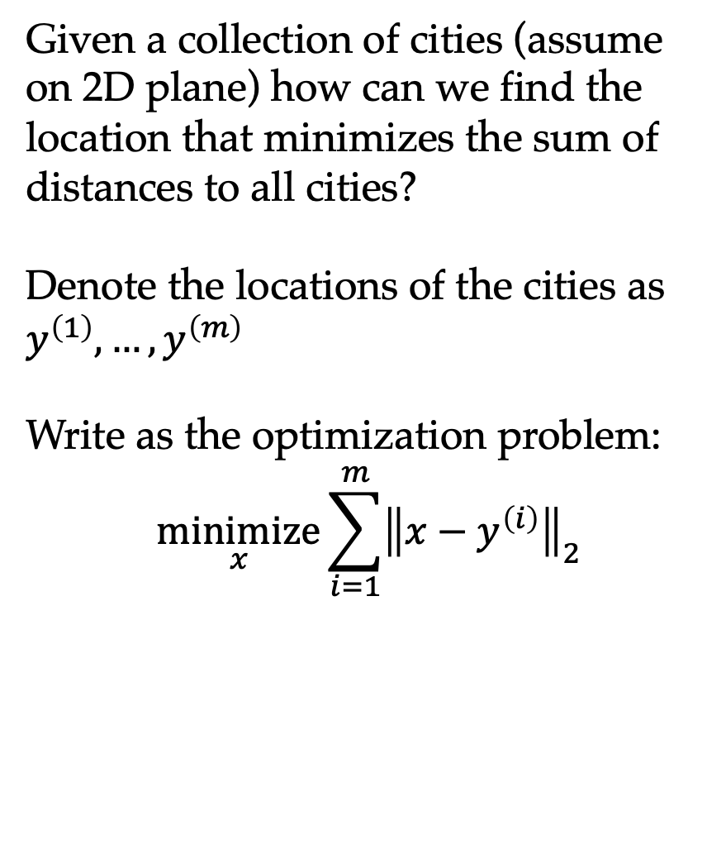
Example: Weber point
Given a collection of cities (assume on 2D plane) how can we find the location that minimizes the sum of distances to all cities?
Denote the locations of the cities as $y^{\left(1\right)},…,y^{\left(m\right)}$
Write as the optimization problem:
$$\underset{x}{minimize}{\sum_{i=1}^{m}{{\left\|x−y^{\left(i\right)}\right\|}_{2}}}$$
?

Slide 8
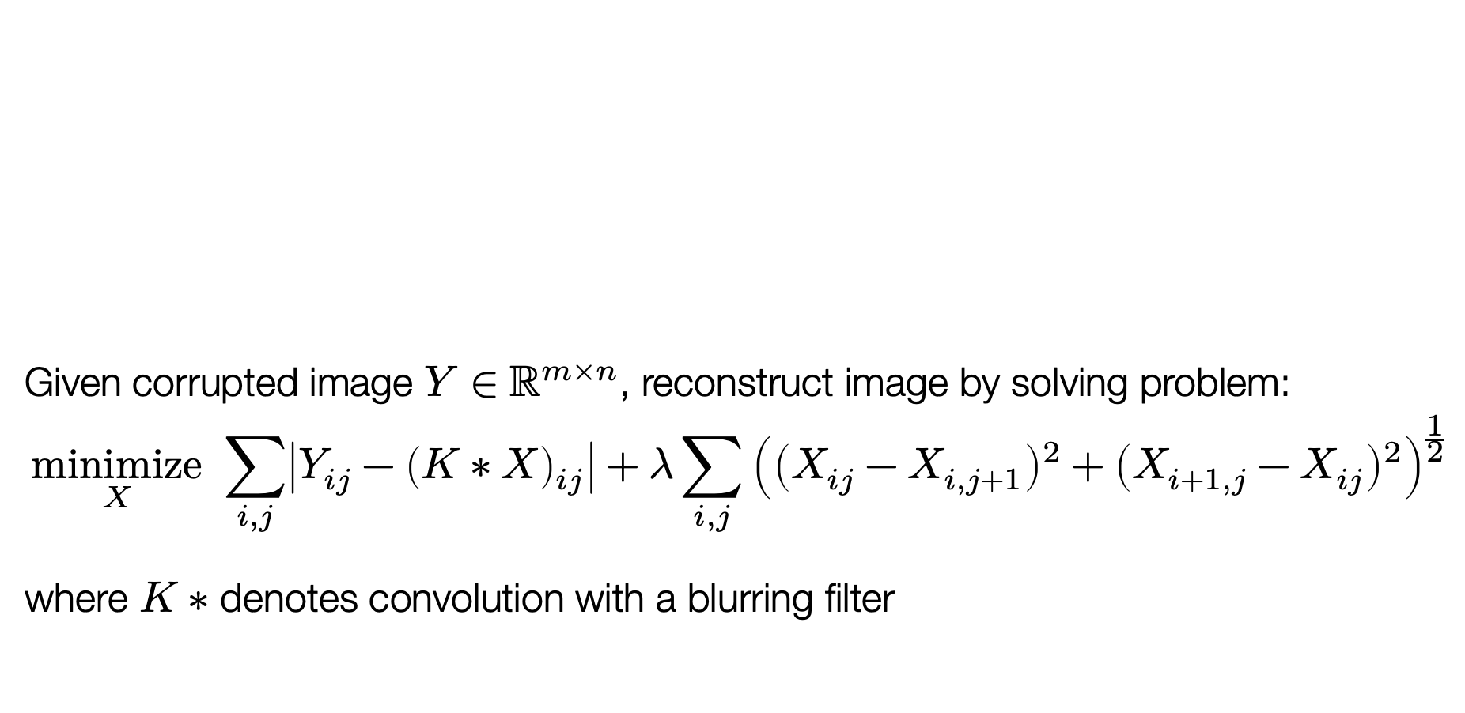
Example: image deblurring
Given corrupted image $Y∈ℝ^{m×n}$, reconstruct image by solving problem:
$$\underset{X}{minimize}{ \sum_{i,j}{\left|Y_{ij}−{\left(K∗X\right)}_{ij}\right|}+λ\sum_{i,j}{{\left({\left(X_{ij}−X_{i,j+1}\right)}^{2}+{\left(X_{i+1,j}−X_{ij}\right)}^{2}\right)}^{\frac{1}{2}}}}$$
where $K∗$ denotes convolution with a blurring filter
Figure from (O’Connor and Vandenberghe, 2014)
Notes:
Salt and pepper noise: with some probability, each pixel is either 0 or 1. Caused by sharp and sudden disturbances in the image signal

Slide 9
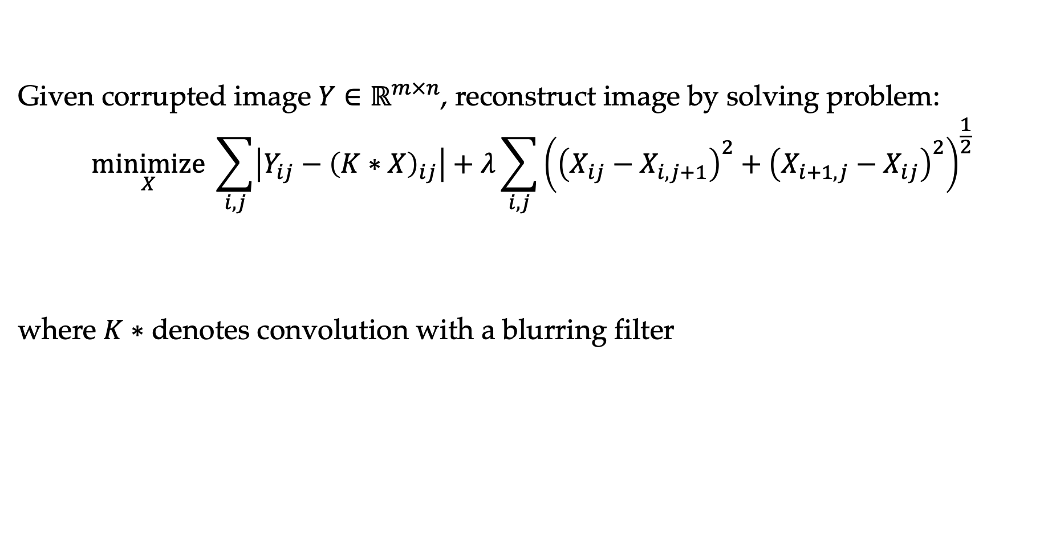
Example: image deblurring
Given corrupted image $Y∈ℝ^{m×n}$, reconstruct image by solving problem:
$$\underset{X}{minimize}{ \sum_{i,j}{\left|Y_{ij}−{\left(K∗X\right)}_{ij}\right|}+λ\sum_{i,j}{{\left({\left(X_{ij}−X_{i,j+1}\right)}^{2}+{\left(X_{i+1,j}−X_{ij}\right)}^{2}\right)}^{\frac{1}{2}}}}$$
where $K∗$ denotes convolution with a blurring filter
Reverse image blurring
”prior” on natural images: nearby pixels are similar
Total variation image deblurring
Notes:
Salt and pepper noise: with some probability, each pixel is either 0 or 1. Caused by sharp and sudden disturbances in the image signal

Slide 10
Example: robot trajectory planning
We want a sequence of control inputs that take a robot from start to goal
Why tricky? Some obstacles, and also can’t simply move along any coordinate at will (joint limits)
One approach: model this as a search problem (sample points in the space, discard ones that hit obstacles and
Figure from (Schulman et al., 2014)
Notes:
U(t): things like joint torques
Dynamics: captures kinematics of the robot arm etc

Slide 11
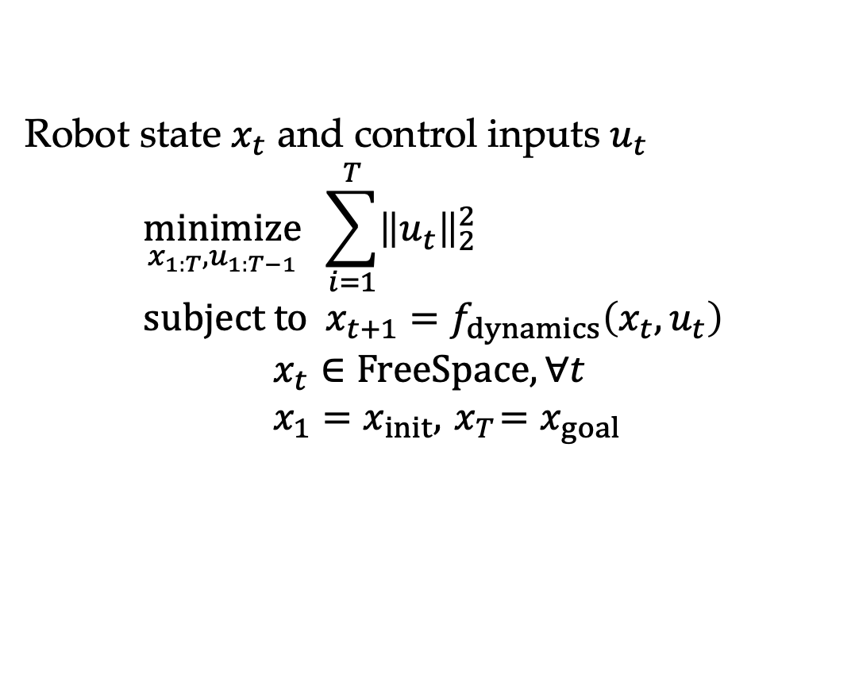
Example: robot trajectory planning
Robot state $x_{t}$ and control inputs $u_{t}$
$$\underset{x_{1:T},u_{1:T−1}}{minimize}{\sum_{i=1}^{T}{{\left\|u_{t}\right\|}_{2}^{2}}} \\ subject to x_{t+1}=f_{dynamics}\left(x_{t},u_{t}\right) \\ x_{t}∈FreeSpace, ∀t \\ x_{1}=x_{init}, { x}_{T}=x_{goal}$$
Figure from (Schulman et al., 2014)
Notes:
U(t): things like joint torques
Dynamics: captures kinematics of the robot arm etc

Slide 12
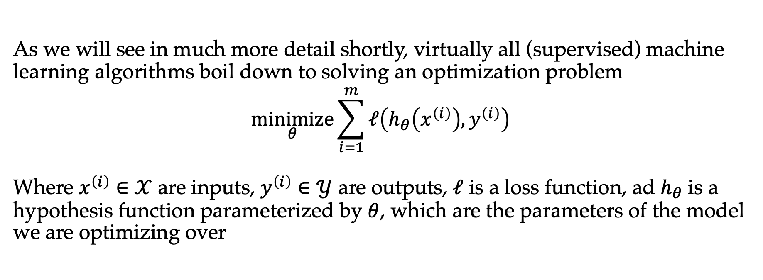
Example: learning from examples
As we will see in much more detail shortly, virtually all (supervised) machine learning algorithms boil down to solving an optimization problem
$$\underset{θ}{minimize}{\sum_{i=1}^{m}{ℓ\left(h_{θ}\left(x^{\left(i\right)}\right),y^{\left(i\right)}\right)}}$$
Where $x^{\left(i\right)}∈𝒳$ are inputs, $y^{\left(i\right)}∈𝒴$ are outputs, $ℓ$ is a loss function, ad $h_{θ}$ is a hypothesis function parameterized by $θ$, which are the parameters of the model we are optimizing over
Find a model that best fits the observed data
Much more on this from next lecture…

Slide 13
The benefit of optimization
One of the key benefits of looking at problems in AI as optimization problems: we separate out the definition of the problem from the method for solving it
For many classes of problems, there are off-the-shelf solvers that will let you solve even large, complex problems, once you have put them in the right form
Notes:
Of course, in many cases, the way we define the optimization problem affects how well we can solve it etc.

Slide 14
Outline
Introduction to optimization
Types of optimization problems, convexity
Solving optimization problems

Slide 15
Classes of optimization problems
Many different names for types of optimization problems: linear programming, quadratic programming, nonlinear programming, semidefinite programming, integer programming, geometric programming, mixed linear binary integer programming
We’re instead going to focus on two dimensions: convex vs. nonconvex and constrained vs. unconstrained
Which problems are easy?
Constrained
Unconstrained
Convex
Nonconvex

Slide 16
Classes of optimization problems
Many different names for types of optimization problems: linear programming, quadratic programming, nonlinear programming, semidefinite programming, integer programming, geometric programming, mixed linear binary integer programming
We’re instead going to focus on two dimensions: convex vs. nonconvex and constrained vs. unconstrained
Constrained
Integer programming
Linear programming
Deep learning
Classical machine learning
Unconstrained
Convex
Nonconvex

Slide 17
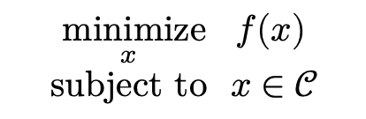
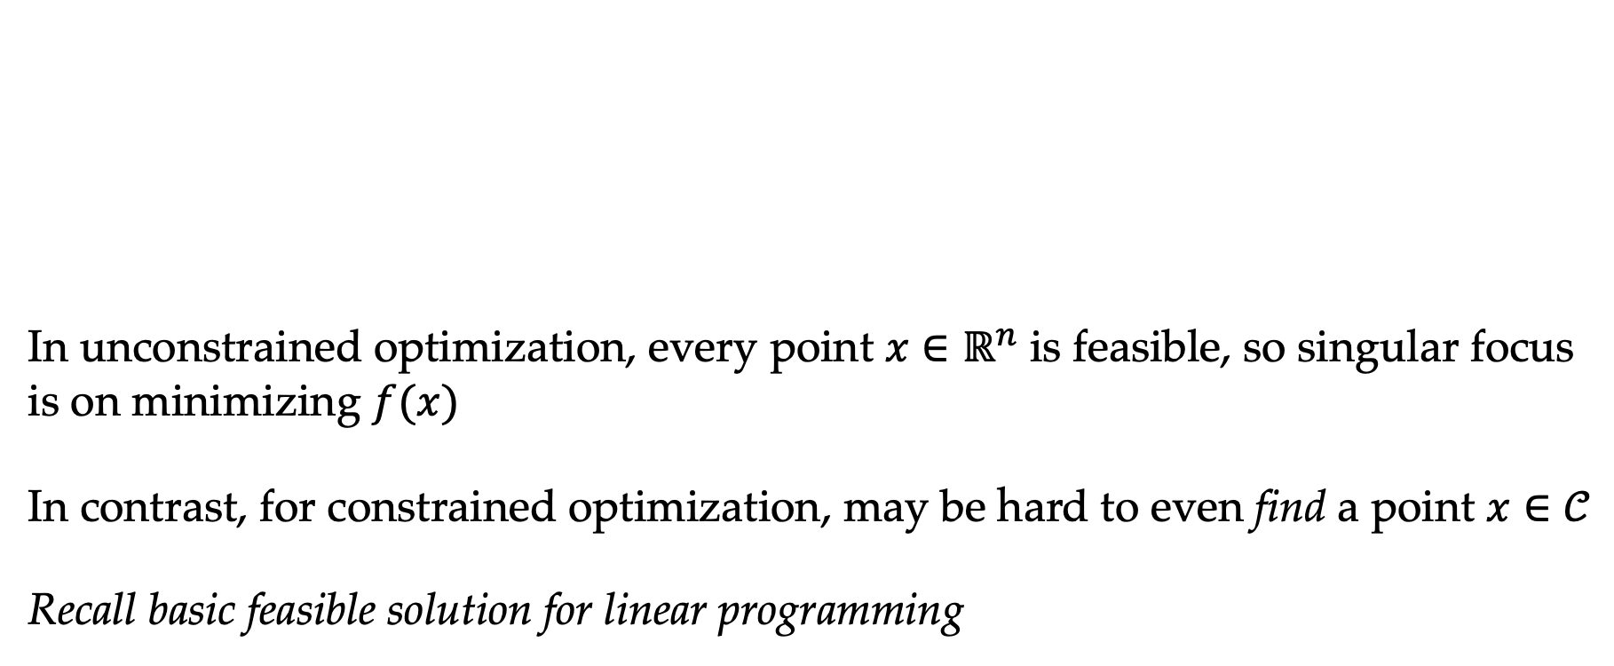

Constrained vs. unconstrained
In unconstrained optimization, every point $x∈ℝ^{n}$ is feasible, so singular focus is on minimizing $f(x)$
In contrast, for constrained optimization, may be hard to even find a point $x∈𝒞$
Recall basic feasible solution for linear programming
$$\underset{x}{minimize}{ f(x)} \\ subject to x∈𝒞$$
$$\underset{x}{minimize}{ f(x)}$$

Slide 18
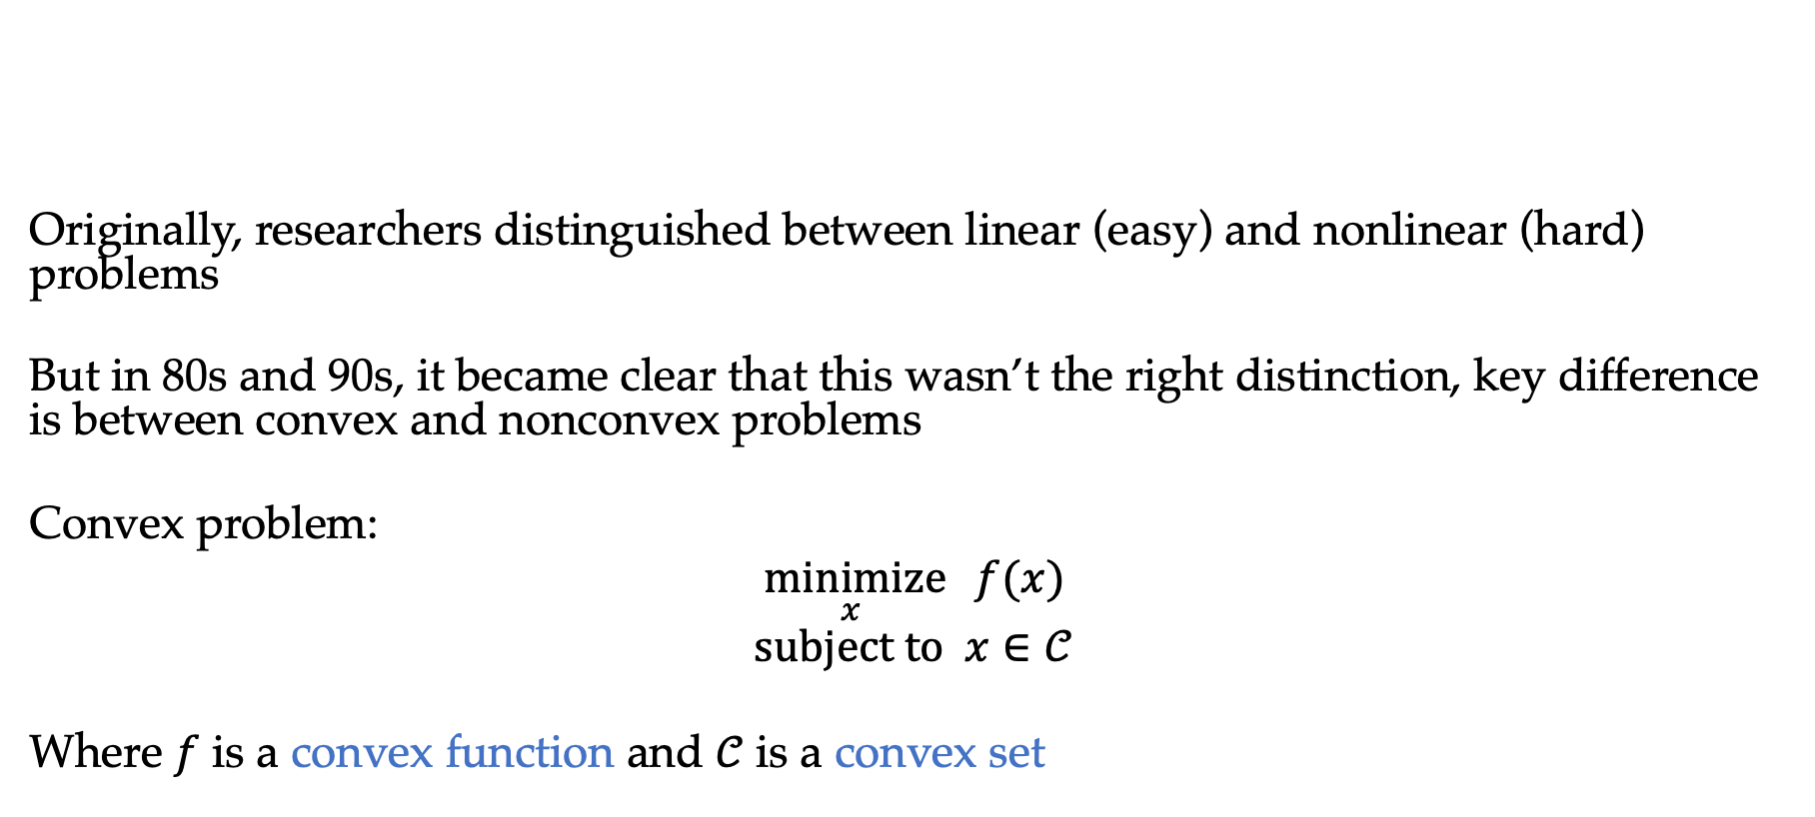
Convex vs. nonconvex optimization
Originally, researchers distinguished between linear (easy) and nonlinear (hard) problems
But in 80s and 90s, it became clear that this wasn’t the right distinction, key difference is between convex and nonconvex problems
Convex problem:
$$\underset{x}{minimize}{ f(x)} \\ subject to x∈𝒞$$
Where $f$ is a convex function and $𝒞$ is a convex set

Slide 19
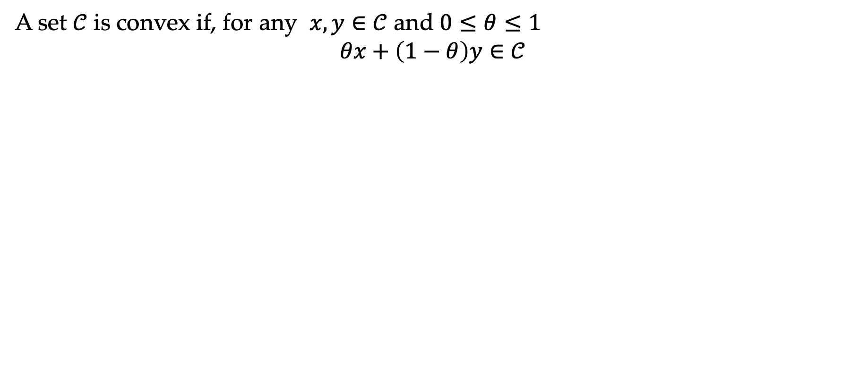
Convex sets
A set $𝒞$ is convex if, for any $x, y∈𝒞$ and $0≤θ≤1$
$$θx+\left(1−θ\right)y∈𝒞$$
Line segment between two points in the set is also in the set

Slide 20
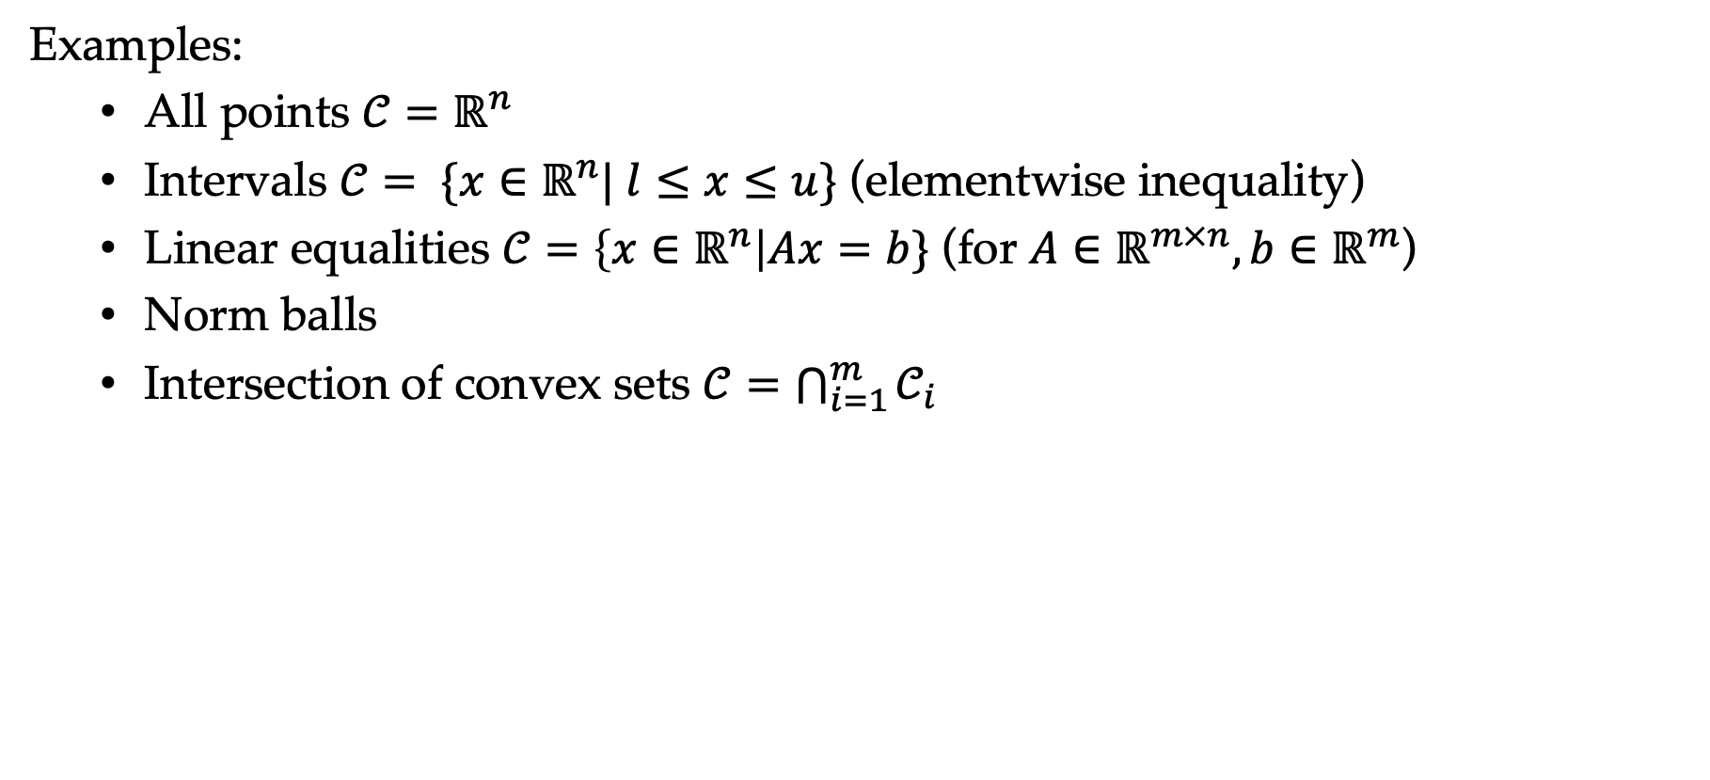
Convex sets
Examples:
  All points $𝒞=ℝ^{n}$
  Intervals $𝒞= \{x∈ℝ^{n}| l≤x≤u\}$ (elementwise inequality)
  Linear equalities $𝒞=\left\{x∈ℝ^{n}\right|Ax=b\}$ (for $A∈ℝ^{m×n},b∈ℝ^{m}$)
  Norm balls
  Intersection of convex sets $𝒞=\bigcap_{i=1}^{m}{𝒞_{i}}$

Slide 21
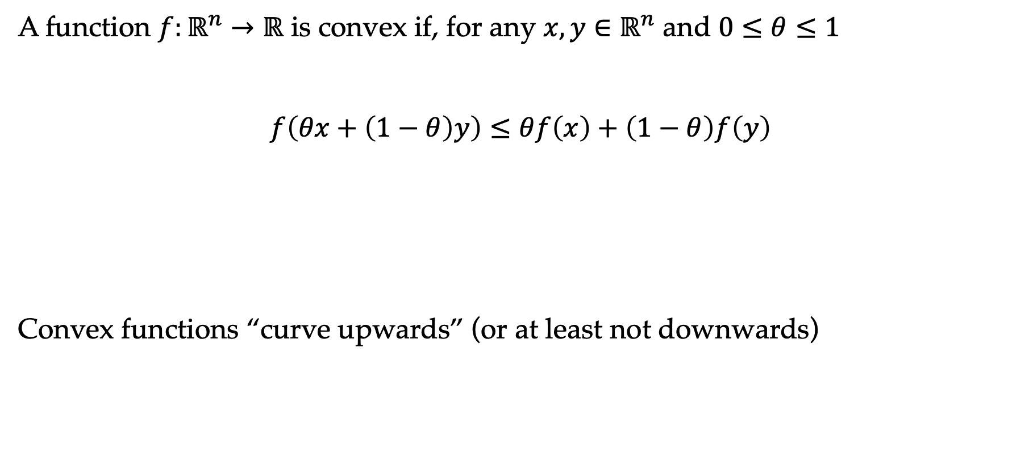
Convex functions
A function $f:ℝ^{n}→ℝ$ is convex if, for any $x,y∈ℝ^{n}$ and $0≤θ≤1$
$$f\left(θx+\left(1−θ\right)y\right)≤θf\left(x\right)+\left(1−θ\right)f\left(y\right)$$
Convex functions “curve upwards” (or at least not downwards)
Function is below the line joining two points

Slide 22
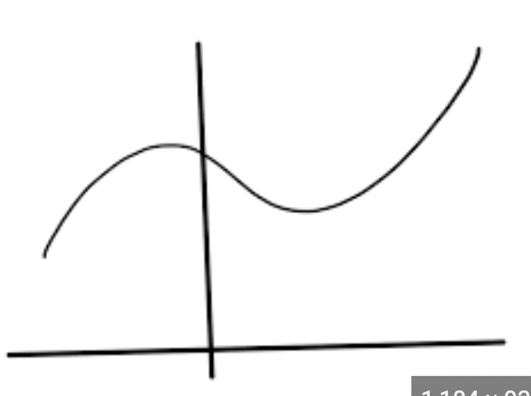
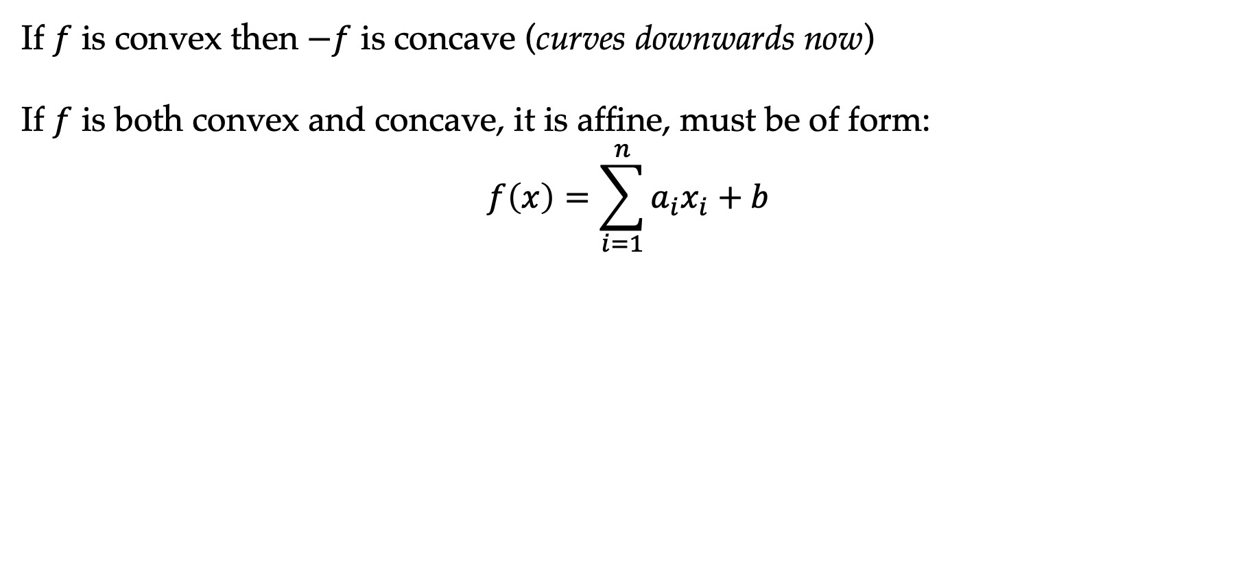
Convex functions
If $f$ is convex then $−f$ is concave (curves downwards now)
If $f$ is both convex and concave, it is affine, must be of form:
$$f\left(x\right)=\sum_{i=1}^{n}{a_{i}x_{i}}+b$$
Function can be neither convex nor concave

Slide 23
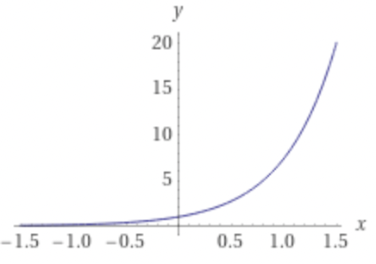
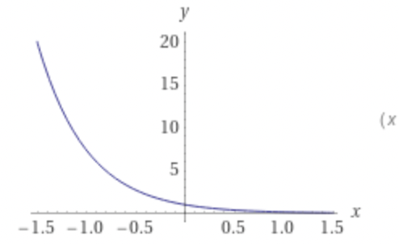
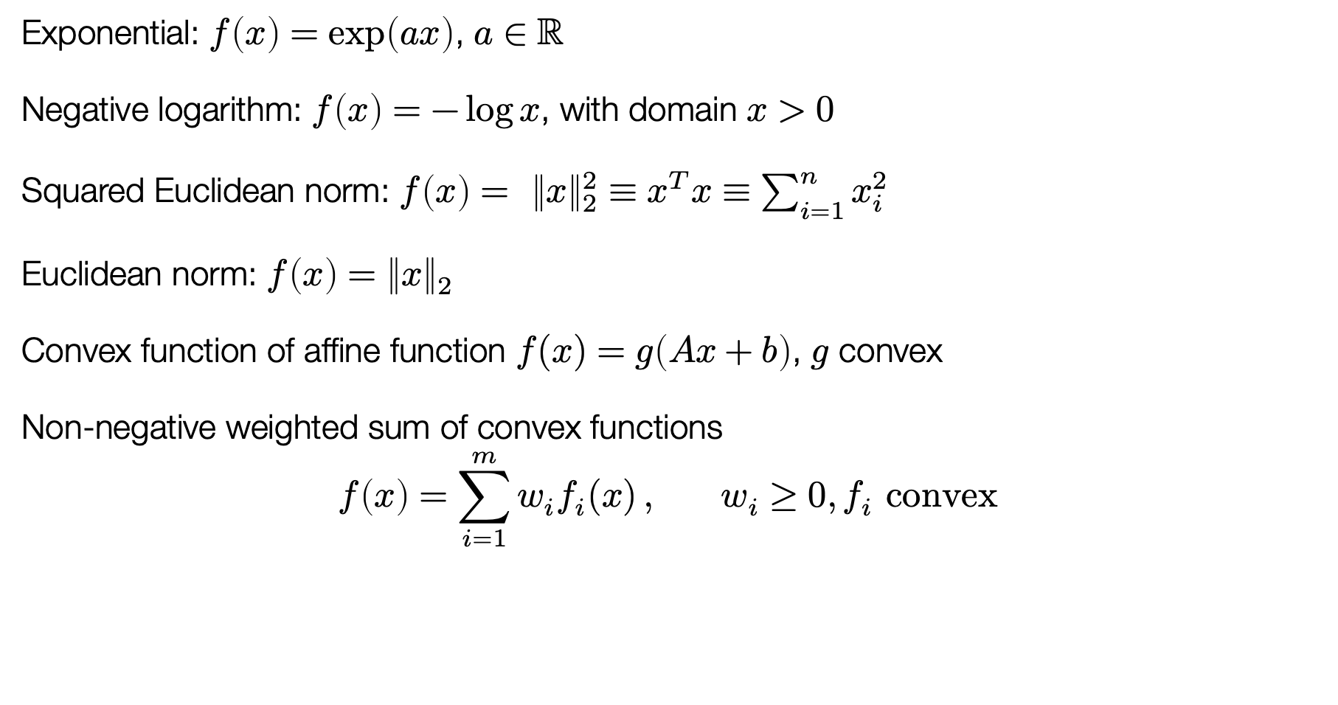
Examples of convex functions
Exponential: $f\left(x\right)=\exp\left(ax\right)$, $a∈ℝ$
Negative logarithm: $f\left(x\right)=−\log{x}$, with domain $x>0$
Squared Euclidean norm: $f\left(x\right)= {\left\|x\right\|}_{2}^{2}≡x^{T}x≡\sum_{i=1}^{n}{x_{i}^{2}}$
Euclidean norm: $f\left(x\right)={\left\|x\right\|}_{2}$
Convex function of affine function $f(x)=g\left(Ax+b\right)$, $g$ convex
Non-negative weighted sum of convex functions
$$f\left(x\right)=\sum_{i=1}^{m}{w_{i}f_{i}(x)}, w_{i}≥0, f_{i} convex$$
Exponential
Negative log
Notes:
Have to keep increasing their curvature
Squared Euclidean norm is convex by triangle inequality

Slide 24
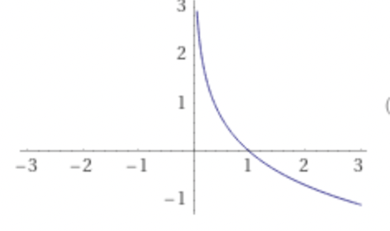
Examples of convex functions
Exponential: $f\left(x\right)=\exp\left(ax\right)$, $a∈ℝ$
Negative logarithm: $f\left(x\right)=−\log{x}$, with domain $x>0$
Squared Euclidean norm: $f\left(x\right)= {\left\|x\right\|}_{2}^{2}≡x^{T}x≡\sum_{i=1}^{n}{x_{i}^{2}}$
Euclidean norm: $f\left(x\right)={\left\|x\right\|}_{2}$
Convex function of affine function $f(x)=g\left(Ax+b\right)$, $g$ convex
Non-negative weighted sum of convex functions
$$f\left(x\right)=\sum_{i=1}^{m}{w_{i}f_{i}(x)}, w_{i}≥0, f_{i} convex$$
Negative log
Notes:
Have to keep increasing their curvature

Slide 25

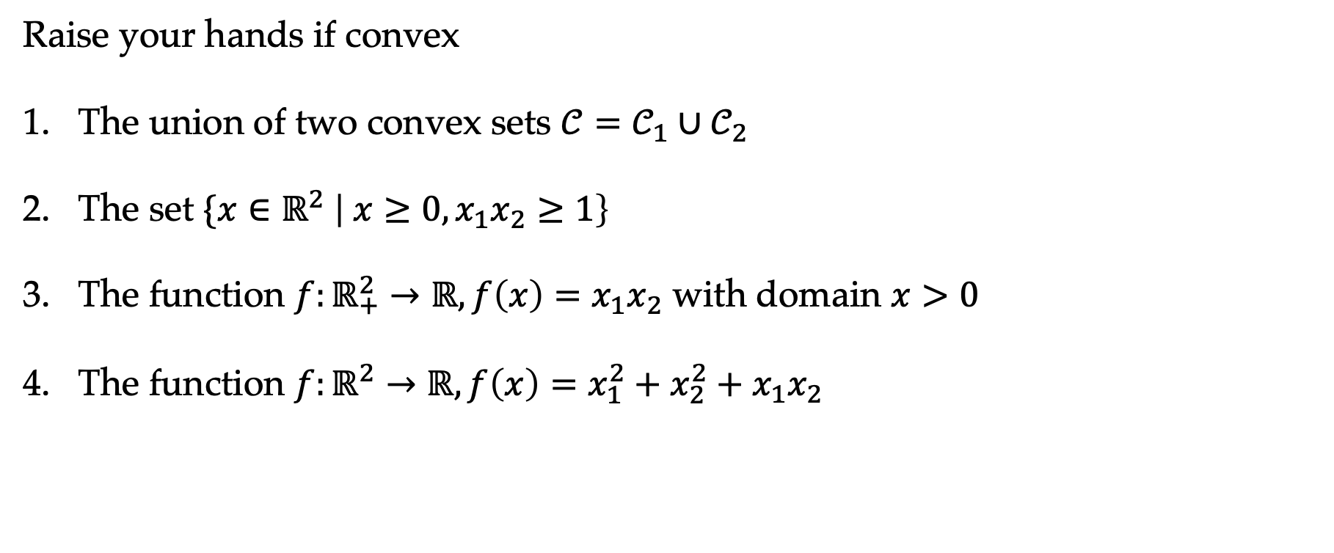
Convex sets and functions
Raise your hands if convex
The union of two convex sets $𝒞=𝒞_{1}∪𝒞_{2}$
The set $\{x∈ℝ^{2} \left| x≥0, x_{1}x_{2}≥1\right\}$
The function $f:ℝ_{+}^{2}→ℝ, f\left(x\right)=x_{1}x_{2}$ with domain $x>0$
The function $f:ℝ^{2}→ℝ, f\left(x\right)=x_{1}^{2}+x_{2}^{2}+x_{1}x_{2}$
Notes:
By counter-example (x_1 x_2 = (1, 2); x_1, x_2 = (2, 1) take average); last one is combination of ½(x_1 + x_2)^2 + ½ x_1^2 + ½ x_2^2

Slide 26
Convex optimization
The key aspect of convex optimization problems that make them tractable is that all local optima are global optima

Slide 27
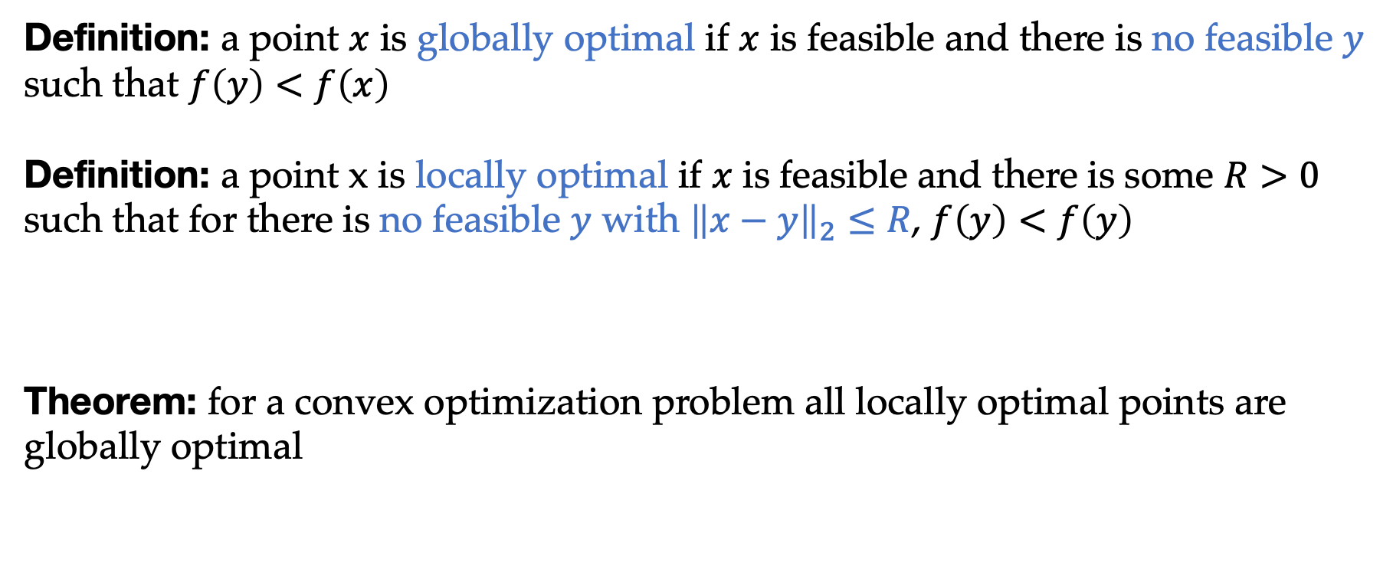
Convex optimization
Definition: a point $x$ is globally optimal if $x$ is feasible and there is no feasible $y$ such that $f\left(y\right)<f\left(x\right)$
Definition: a point x is locally optimal if $x$ is feasible and there is some $R>0$ such that for there is no feasible $y$ with ${\left\|x−y\right\|}_{2}≤R$, $f\left(y\right)<f\left(y\right)$
Theorem: for a convex optimization problem all locally optimal points are globally optimal

Slide 28

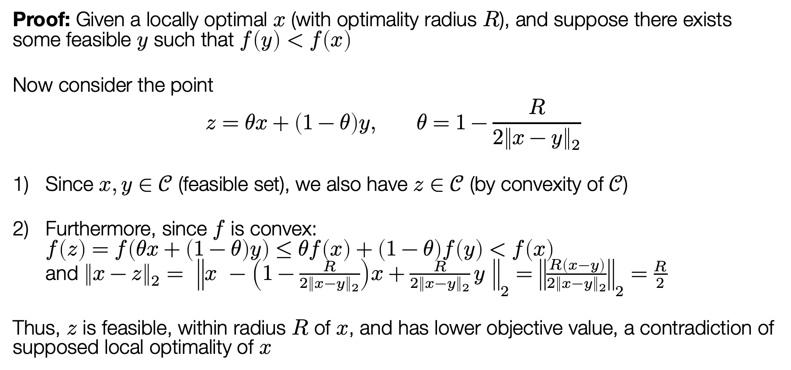
Proof of global optimality
Proof: Given a locally optimal $x$ (with optimality radius $R$), and suppose there exists some feasible $y$ such that $f\left(y\right)<f\left(x\right)$
Now consider the point
$$z=θx+\left(1−θ\right)y, θ=1−\frac{R}{2{\left\|x−y\right\|}_{2}}$$
Since $x,y∈𝒞$ (feasible set), we also have $z∈𝒞$ (by convexity of $𝒞$)
Furthermore, since $f$ is convex:
$f\left(z\right)=f\left(θx+\left(1−θ\right)y\right)≤θf\left(x\right)+\left(1−θ\right)f\left(y\right)<f\left(x\right)$
and ${\left\|x−z\right\|}_{2}= {\left\|x −\left(1−\frac{R}{2{\left\|x−y\right\|}_{2}}\right)x+\frac{R}{2{\left\|x−y\right\|}_{2}}y \right\|}_{2}={\left\|\frac{R\left(x−y\right)}{2{\left\|x−y\right\|}_{2}}\right\|}_{2}=\frac{R}{2}$
Thus, $z$ is feasible, within radius $R$ of $x$, and has lower objective value, a contradiction of supposed local optimality of $x$
$$∎$$

Slide 29
Local optimality => global optimality
If you are not at the minima of a convex function, there is a direction that reduces your function value locally
We used both convexity of feasible set and convexity of objective

Slide 30
Outline
Introduction to optimization
Types of optimization problems, convexity
Solving optimization problems

Slide 31
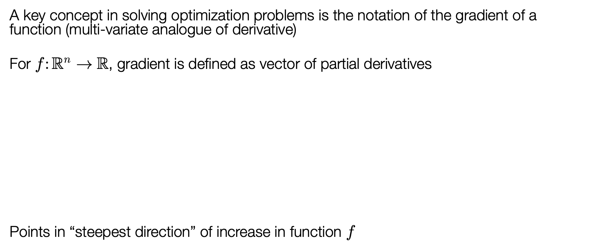
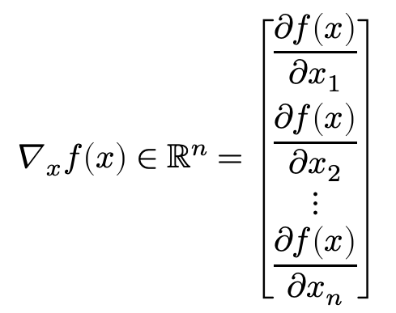
The gradient
A key concept in solving optimization problems is the notation of the gradient of a function (multi-variate analogue of derivative)
For $f:ℝ^{n}→ℝ$, gradient is defined as vector of partial derivatives
Points in “steepest direction” of increase in function $f$
$$∇_{x}f\left(x\right)∈ℝ^{n}=\left[\begin{aligned}\frac{∂f\left(x\right)}{∂x_{1}} \\ \frac{∂f\left(x\right)}{∂x_{2}} \\ ⋮ \\ \frac{∂f\left(x\right)}{∂x_{n}}\end{aligned}\right]$$
Notes:
Every direction you’re trying to increase, so it’s the steepest direction. Derivative is the direction of increase

Slide 32
First-order condition for convexity
Notes:
½( f(y + t(x-y)) – f(y)) \leq f(x) – f(y)

Slide 33
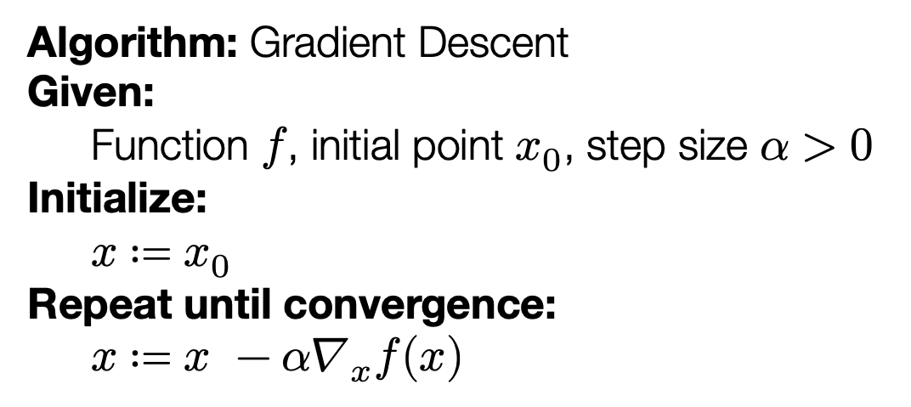
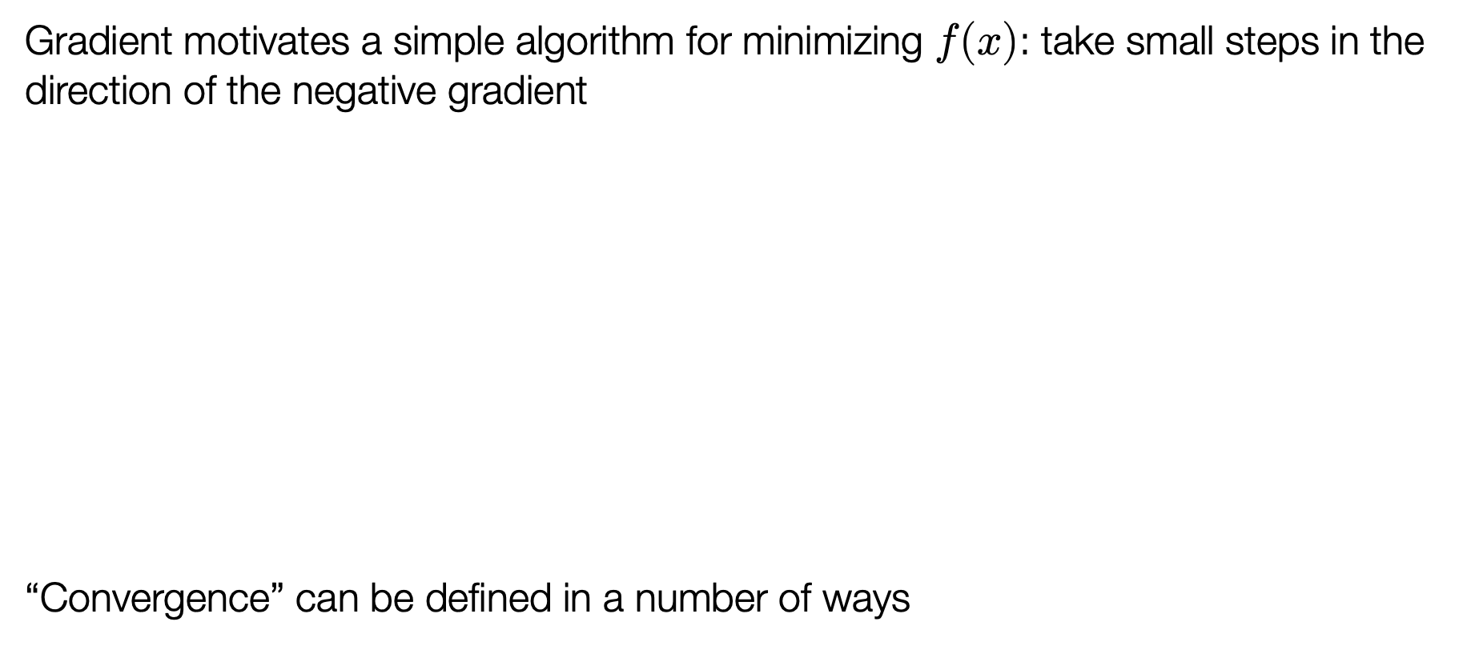
Gradient descent
Gradient motivates a simple algorithm for minimizing $f(x)$: take small steps in the direction of the negative gradient
“Convergence” can be defined in a number of ways
Algorithm: Gradient Descent
Given:
Function $f$, initial point $x_{0}$, step size $α>0$
Initialize:
$x≔x_{0}$
Repeat until convergence:
$x≔x −α∇_{x}f(x)$

Slide 34
Why does gradient descent work?
Smooth function: Derivative exists everywhere, and gradient is L-Lipschitz

Slide 35
Why does gradient descent work?
Smooth function: Derivative exists everywhere, and gradient is L-Lipschitz
Function value decreases

Slide 36
Why does gradient descent work?
Convexity: First-order condition
Convexity
Smoothness

Slide 37
Why does gradient descent work?
Convexity: First-order condition
Convexity
Smoothness

Slide 38
Why does gradient descent work?
Convexity: First-order condition
Convexity
Smoothness

Slide 39
Why does gradient descent work?
Convexity
Smoothness

Slide 40
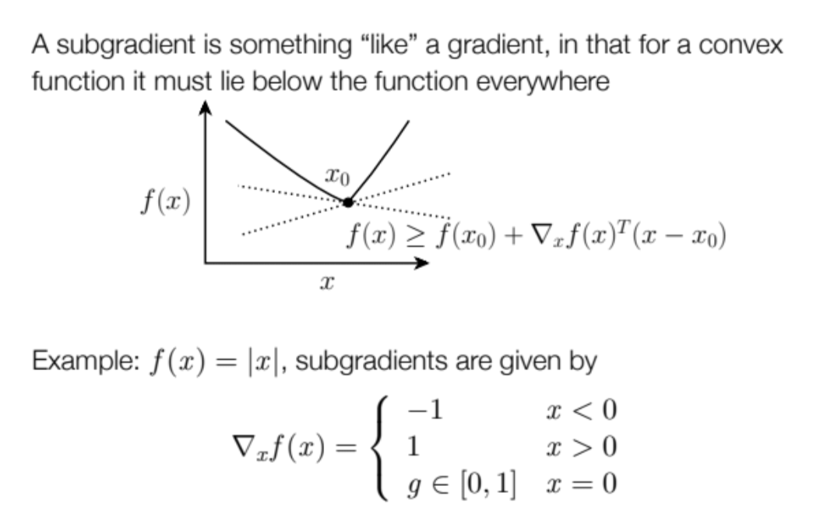
When does gradient descent work?
Do you need derivative to exist?
Subgradient
Method: subgradient “descent”
Need a decreasing sequence of step sizes…
Theory and practice of convergence is quite different

Slide 41
When does gradient descent work?
Do you need convexity?
Local optimality no longer implies global optimality
Works surprisingly well in practice…

Slide 42

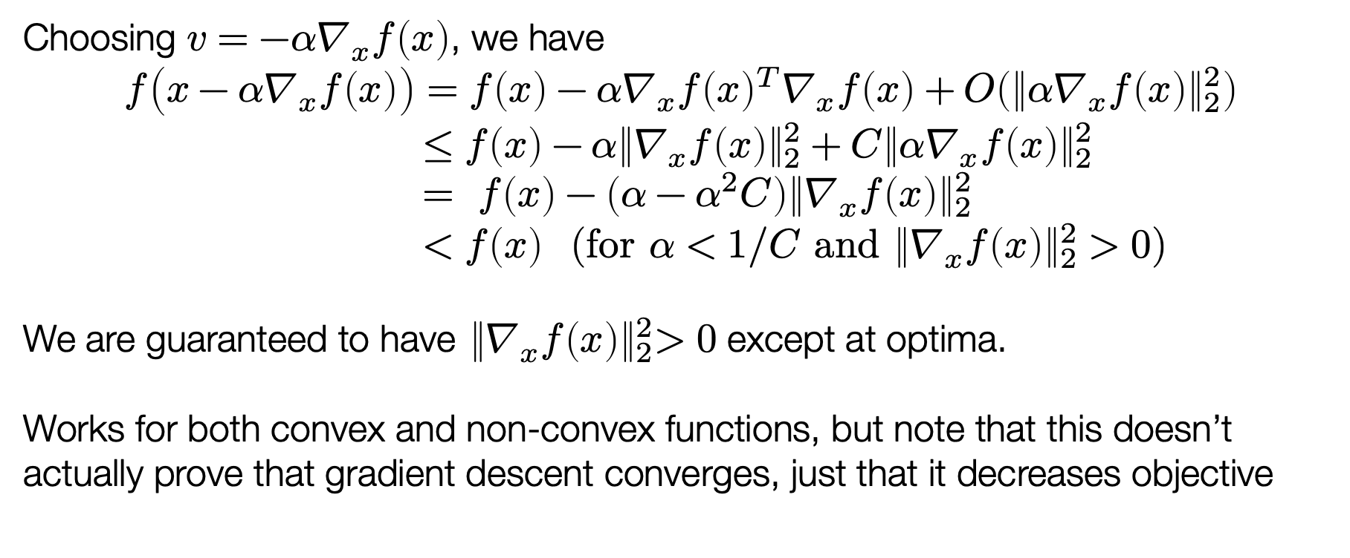
Gradient descent works (cont)
Choosing $v=−α∇_{x}f\left(x\right)$, we have
$$f\left(x−α∇_{x}f\left(x\right)\right)=f\left(x\right)−α∇_{x}f{\left(x\right)}^{T}∇_{x}f\left(x\right)+O\left({\left\|{α∇}_{x}f\left(x\right)\right\|}_{2}^{2}\right) \\ ≤f\left(x\right)−α{\left\|∇_{x}f\left(x\right)\right\|}_{2}^{2}+C{\left\|α∇_{x}f\left(x\right)\right\|}_{2}^{2} \\ = f\left(x\right)−\left(α−α^{2}C\right){\left\|∇_{x}f\left(x\right)\right\|}_{2}^{2} \\ <f\left(x\right) (for α<1/C and{ \left\|∇_{x}f\left(x\right)\right\|}_{2}^{2}>0)$$
We are guaranteed to have${ \left\|∇_{x}f\left(x\right)\right\|}_{2}^{2}>0$ except at optima.
Works for both convex and non-convex functions, but note that this doesn’t actually prove that gradient descent converges, just that it decreases objective
$$∎$$

Slide 43
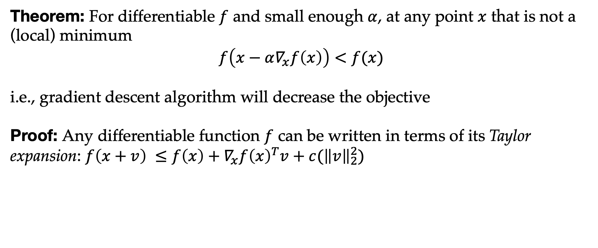
Gradient descent works
Theorem: For differentiable $f$ and small enough $α$, at any point $x$ that is not a (local) minimum
$$f\left(x−α∇_{x}f\left(x\right)\right)<f(x)$$
i.e., gradient descent algorithm will decrease the objective
Proof: Any differentiable function $f$ can be written in terms of its Taylor expansion: $f\left(x+v\right) ≤f\left(x\right)+∇_{x}f{\left(x\right)}^{T}v+c({\left\|v\right\|}_{2}^{2})$
Notes:
Not a complete proof because alpha can keep going down..
For the proof, probably work out in terms of Taylor expansions in each dimension

Slide 44
Gradient descent works
Theorem: For differentiable $f$ and small enough $α$, at any point $x$ that is not a (local) minimum
$$f\left(x−α∇_{x}f\left(x\right)\right)<f(x)$$
i.e., gradient descent algorithm will decrease the objective
Proof: Any differentiable function $f$ can be written in terms of its Taylor expansion: $f\left(x+v\right) ≤f\left(x\right)+∇_{x}f{\left(x\right)}^{T}v+c({\left\|v\right\|}_{2}^{2})$
Notes:
Not a complete proof because alpha can keep going down..
For the proof, probably work out in terms of Taylor expansions in each dimension

Slide 45
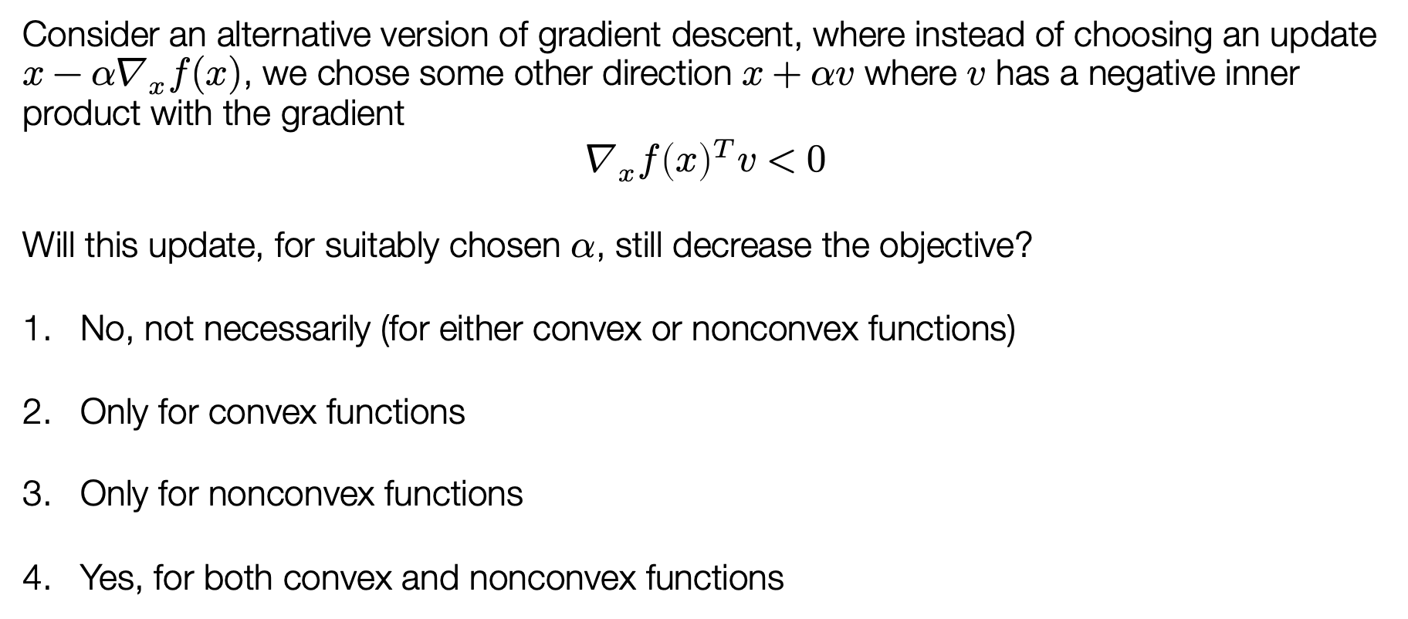
Poll: modified gradient descent
Consider an alternative version of gradient descent, where instead of choosing an update $x−α∇_{x}f(x)$, we chose some other direction $x+αv$ where $v$ has a negative inner product with the gradient
$$∇_{x}f{\left(x\right)}^{T}v<0$$
Will this update, for suitably chosen $α$, still decrease the objective?
No, not necessarily (for either convex or nonconvex functions)
Only for convex functions
Only for nonconvex functions
Yes, for both convex and nonconvex functions

Slide 46

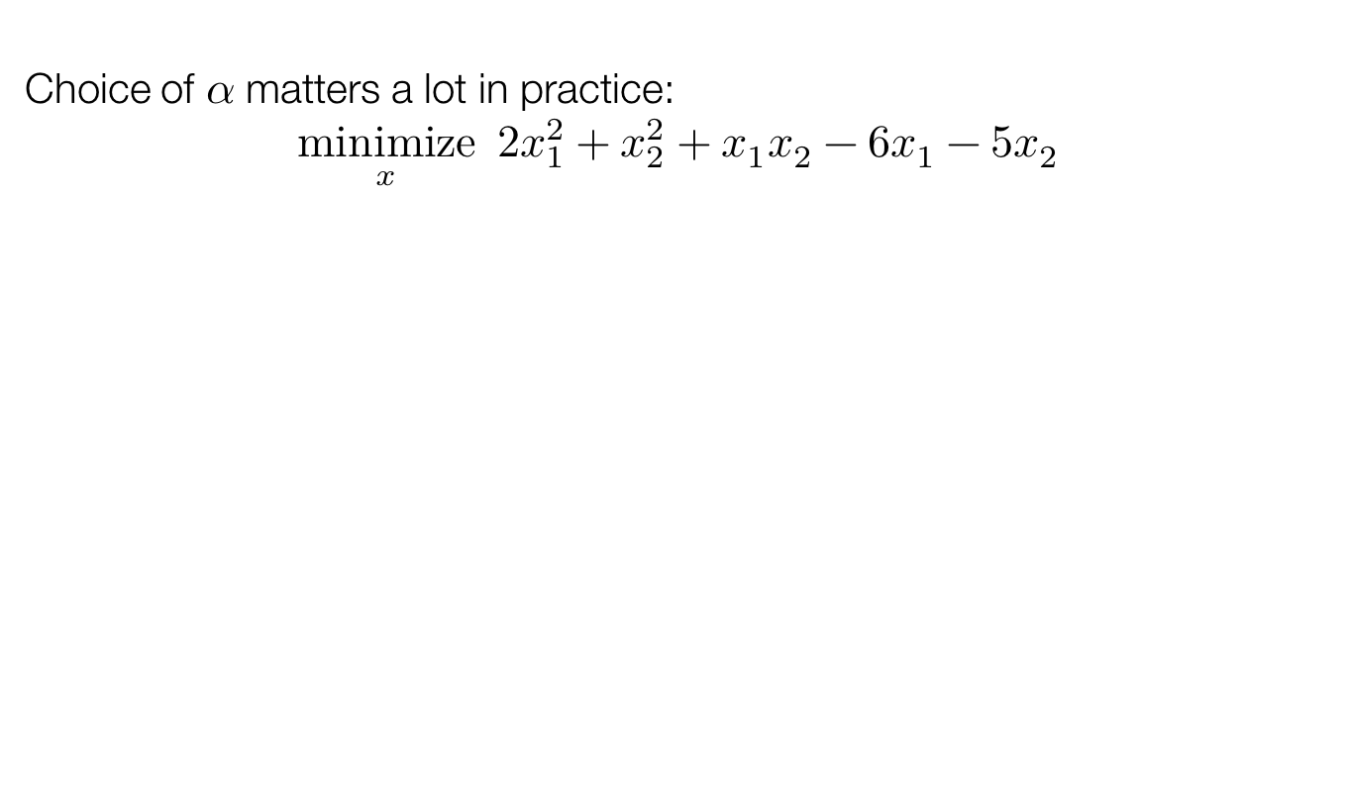


Gradient descent in practice
Choice of $α$ matters a lot in practice:
$$\underset{x}{minimize}{ 2x_{1}^{2}+x_{2}^{2}+x_{1}x_{2}−6x_{1}−5x_{2}}$$
$$α=0.05$$
$$α=0.2$$
$$α=0.42$$

Slide 47
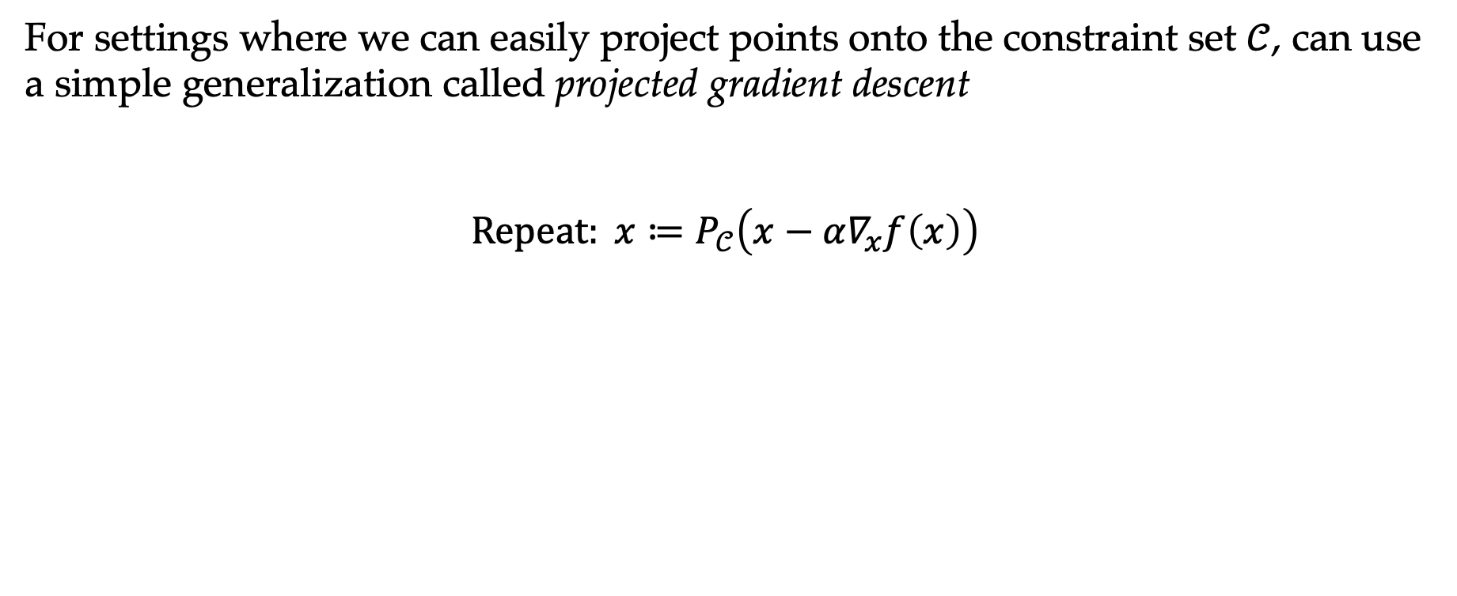
Dealing with constraints
For settings where we can easily project points onto the constraint set $𝒞$, can use a simple generalization called projected gradient descent
$$Repeat: x≔P_{𝒞}\left(x−α∇_{x}f\left(x\right)\right)$$

Slide 48
Optimization in practice
We won’t discuss this too much yet, but one of the beautiful properties of optimization problems is that there exists a wealth of tools that can solve them using very simple notation
Example: solving Weber point problem using cvxpy (http://cvxpy.org)
import numpy as np
import cvxpy as cp
n,m = (5,10)
y = np.random.randn(n,m)
x = cp.Variable(n)
f = sum(cp.norm2(x - y[:,i]) for i in range(m))
cp.Problem(cp.Minimize(f), []).solve()

